Slide 1
Assignment #2 Wafer Map Pattern Recognition

Slide 2
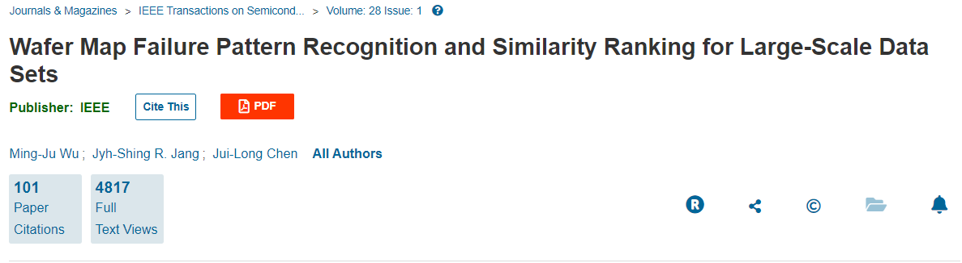
Dataset Source.

Slide 3
Assignment #2.
Deadline 11st May 23:59 (Wednesday)
Weight 30% / 100%
You have to upload your code to eeclass
Format .ipynb / .py
Use the link to register for assignment 2
https://www.kaggle.com/c/wafer-map-hw2

Slide 4
Scoring.
Scoring of this homework will based on your ranking in Kaggle
For example, if there are 20 people achieved the MAE score better than the benchmark, 2 of them will score 95, another 5 people score 90, while another 5 people will score 85 and the rest 80.
Candidate | MCAUC Score | Score in Assignment #1 | Remark
A | 0.91 | 100 | Top 1
B | 0.90 | 99 | Top 2
C | 0.89 | 98 | Top 3
D | 0.88 | 95 | Top 25% after benchmark
E | 0.87 | 90 | Percentile of 26% - 50% after benchmark
F | 0.86 | 85 | Percentile of 51% - 75% after benchmark
G | 0.85 | 80 | Percentile of 76% - 100% after benchmark
Benchmark | 0.84525 | -
H | 0.15060 | 70
Baseline | 0.73372 | -
F | 0.35400 | 0

Slide 5
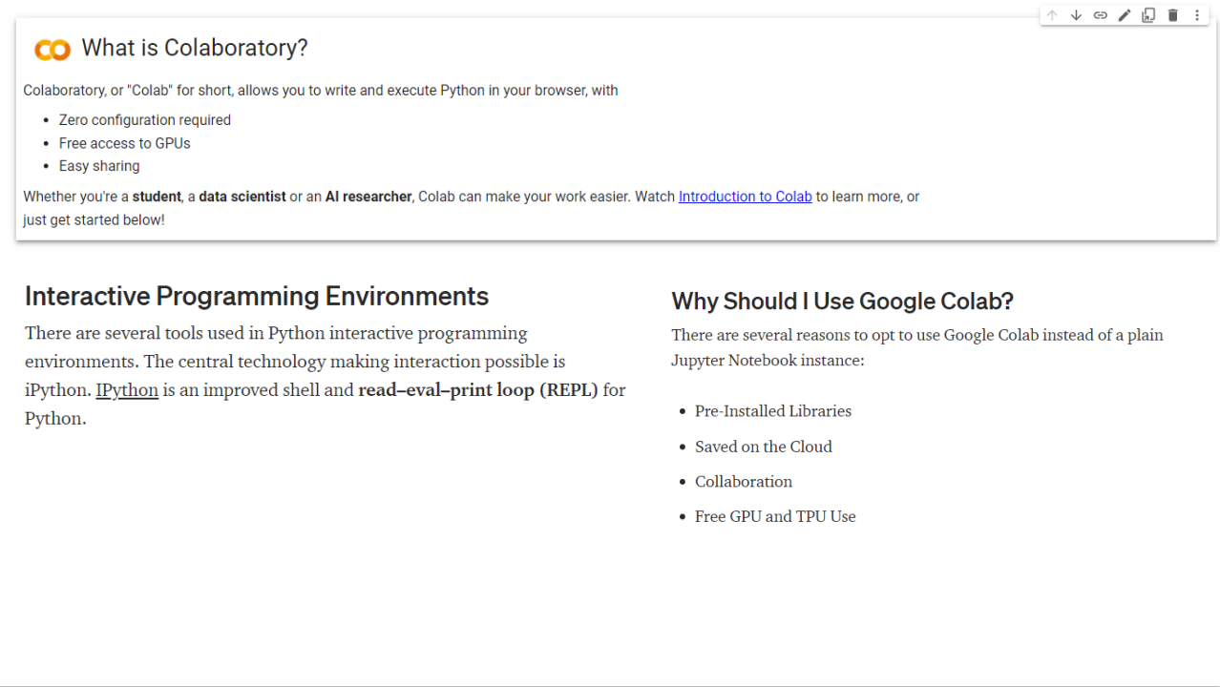

Slide 6
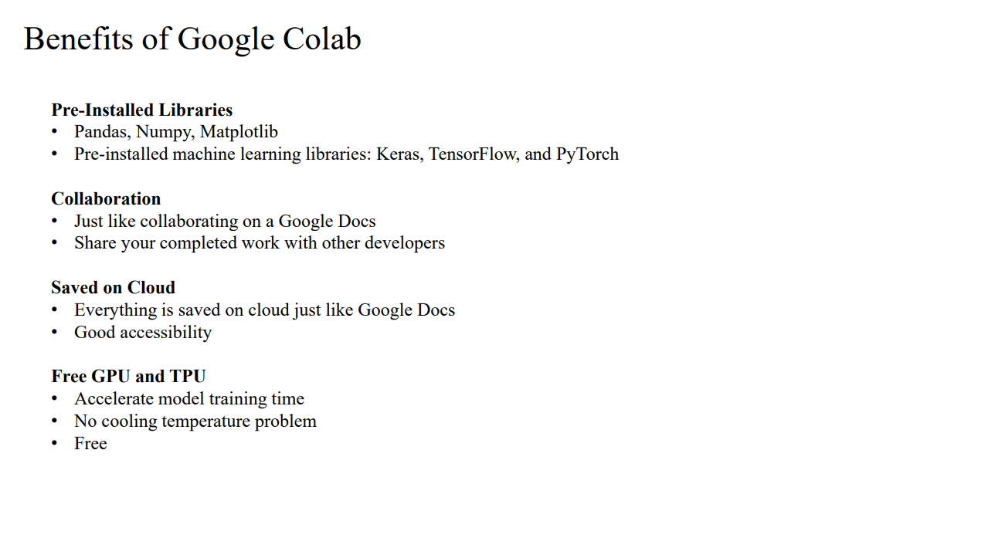

Slide 7
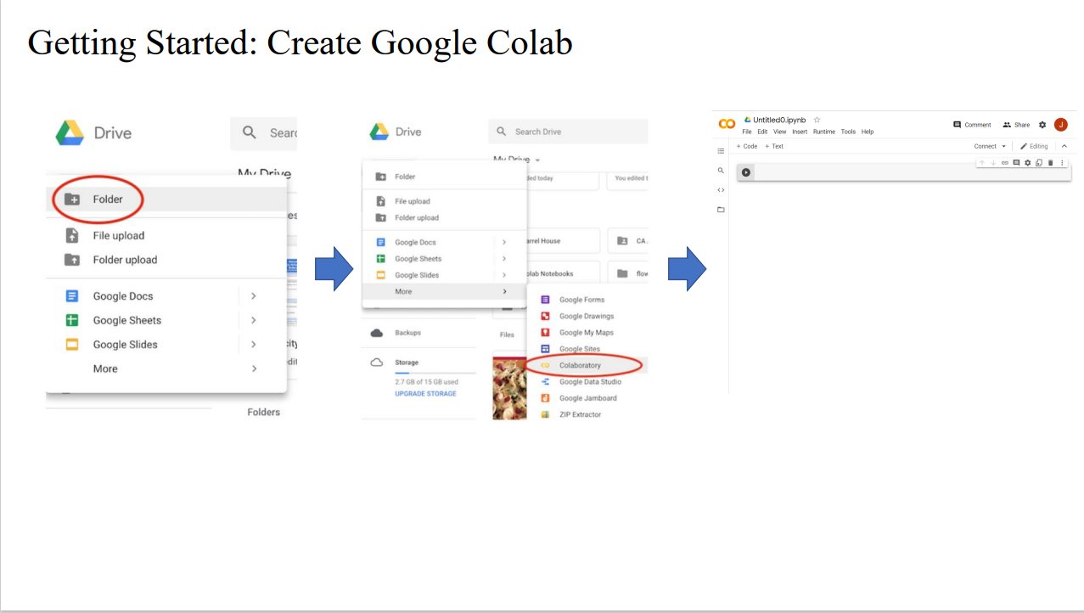

Slide 8
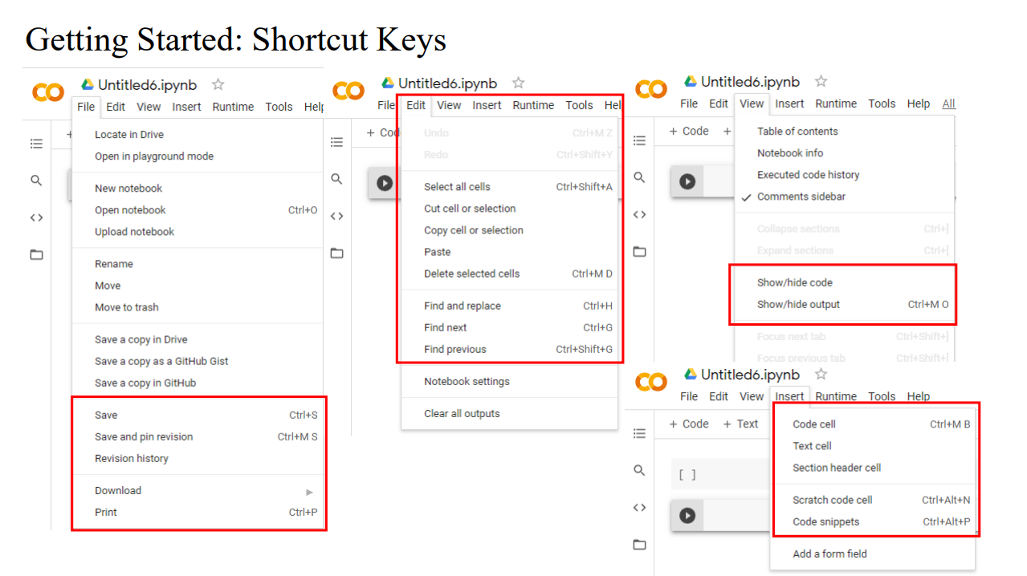

Slide 9
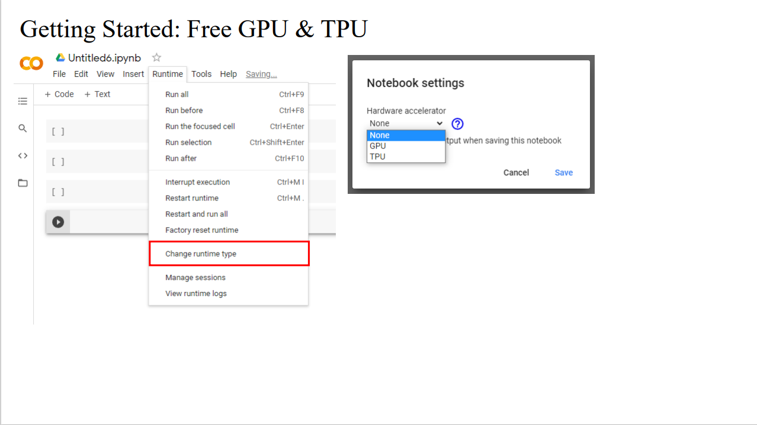

Slide 10
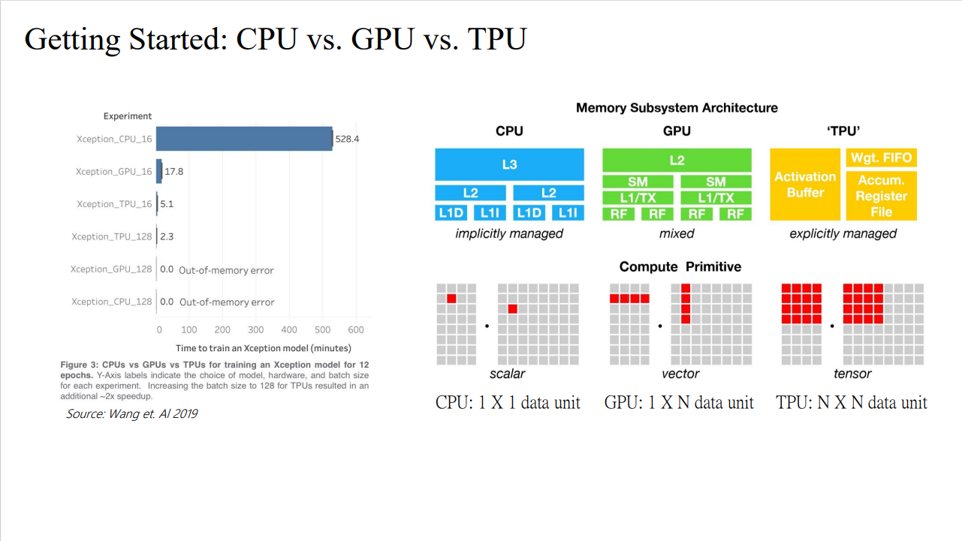

Slide 11
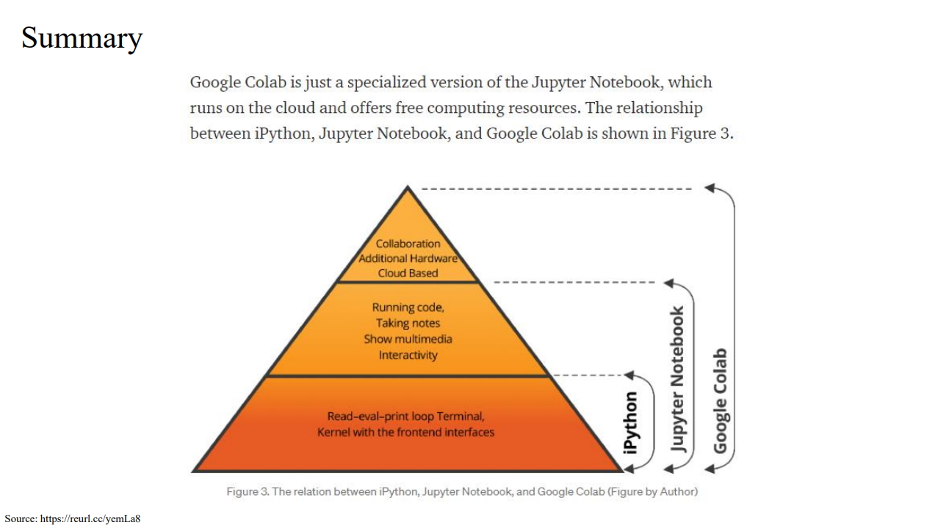

Slide 12
Resource
https://ieeexplore.ieee.org/abstract/document/6932449
https://github.com/fr407041/WM-811K_semiconductor_wafer_map_pattern_classified
https://cs230.stanford.edu/projects_fall_2019/posters/26259758.pdf?fbclid=IwAR2IfT6uFUVkNddXfg9V_s_EkOf6Fhc0rWqh2Wg93KFYXNOGvq-HxcAOtvo
https://research.google.com/colaboratory/faq.html#:~:text=Colaboratory%2C%20or%20%E2%80%9CColab%E2%80%9D%20for,learning%2C%20data%20analysis%20and%20education.

